Slide 1
Movie Recommendation System Using Linear Kernel and KNN
Garland Qiu
CSC 44700P
Professor Grimmelmann

Slide 2
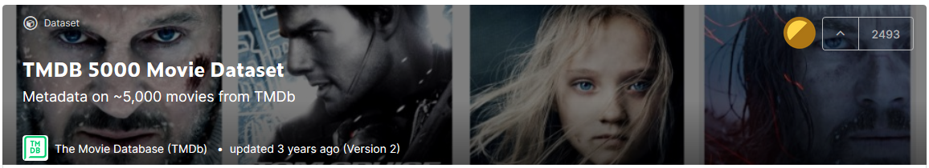
Dataset Used
https://www.kaggle.com/tmdb/tmdb-movie-metadata?select=tmdb_5000_movies.csv
https://www.kaggle.com/tmdb/tmdb-movie-metadata?select=tmdb_5000_credits.csv

Slide 3
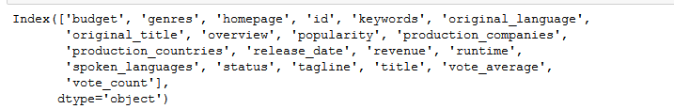
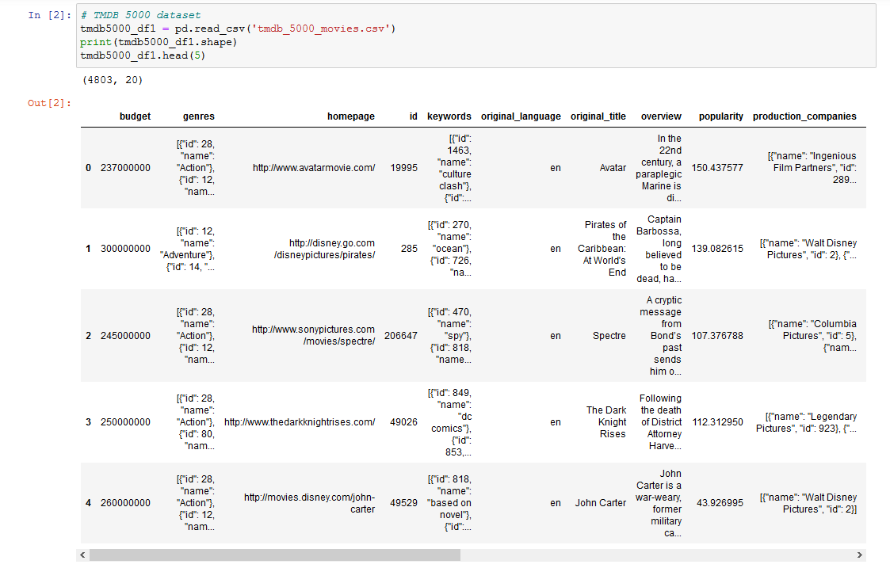
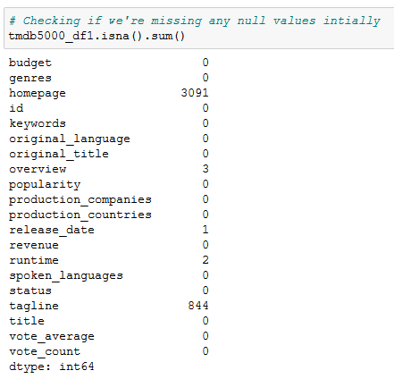
Tmdb_5000_movies.csv

Slide 4
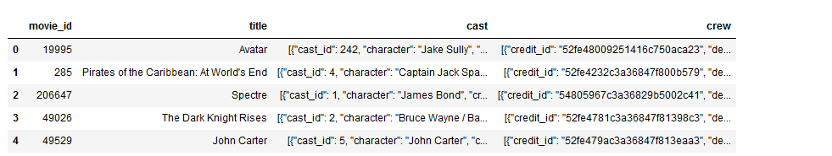
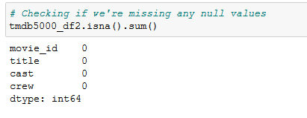
tmdb_5000_credits.csv

Slide 5
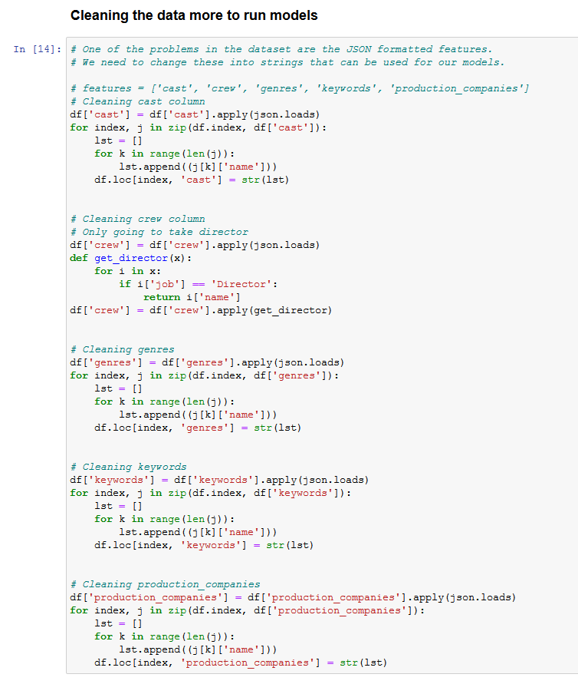
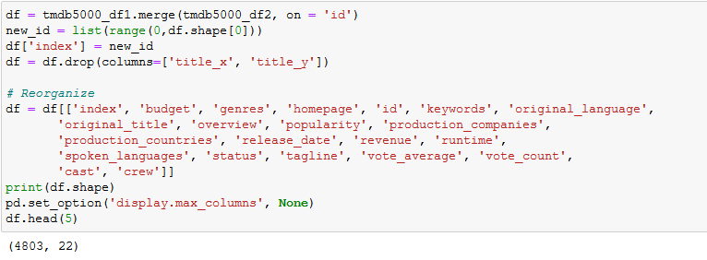
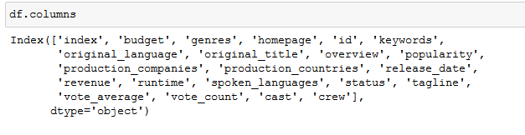
Merging and Cleaning the Data

Slide 6
Content Based Filtering
In this type of recommendation system, the contents or features of a movie, such as its overview, cast, crew, etc., are used to recommend to the user.
Other types of system, such as collaborative filtering are used to recommend something that other users have used or tried before.

Slide 7
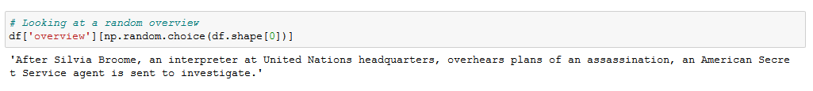
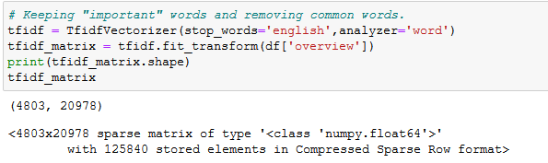
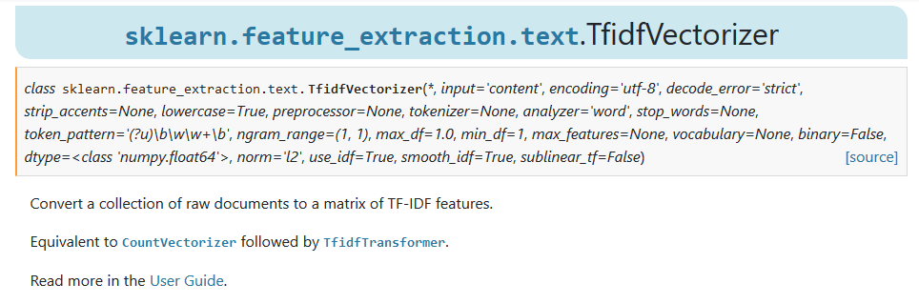
Linear Kernel using Movie Overviews
Part of SVM; mainly used for pattern analysis and text classification.
All the overviews are taken and then converted into a matrix with weights on the words.

Slide 8
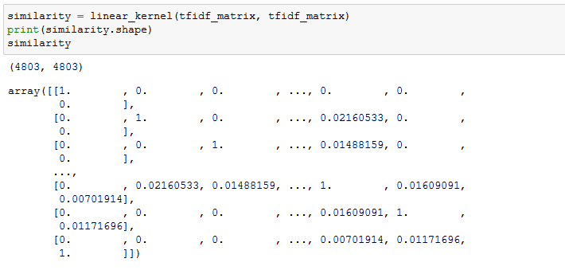
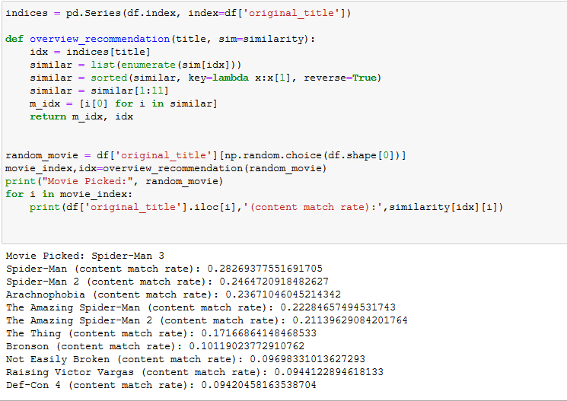
Linear Kernel using Movie Overviews...
Based on these results, recommending movies based on context would be very weak, as we are only basing this off overviews, which typically is a hook line for people to watch a movie. However, this does not mean it is not unreliable, as some results do help recommend other movies similar to it.

Slide 9
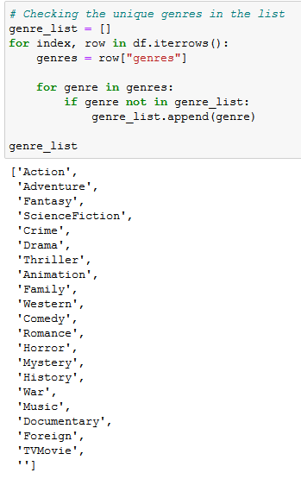
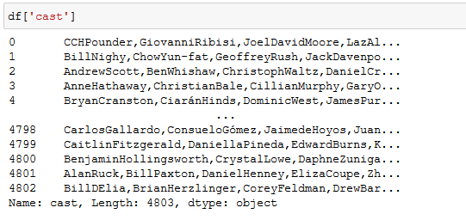
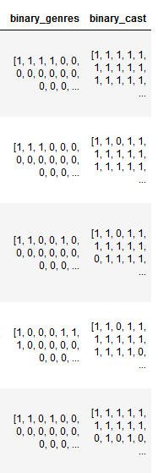
KNN with Genre and the Cast as Features
In order to use KNN with our dataset, genre and features needed to be in a list, where 1 represents that the movie is in that specific index of unique genre or cast.

Slide 10
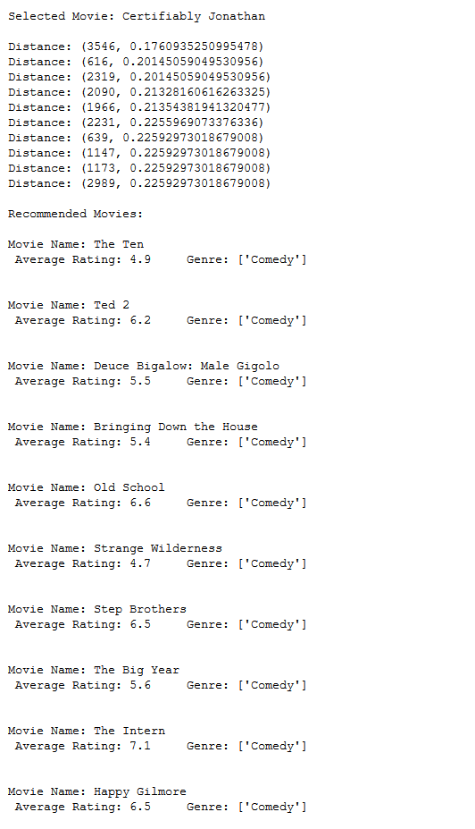
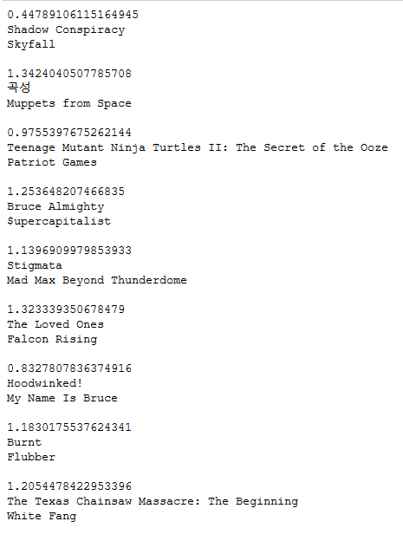
KNN with Genre and the Cast as Features
Based on the results, it's hard to use this as a good recommendation for movies in general aside from just recommending movies with certain actors in it. There may be distances between two movies that are smaller than 0.5, but it's hard to consider it a good recommendation as they are only related in genre and actors, and not the context of the movie itself.

Slide 11
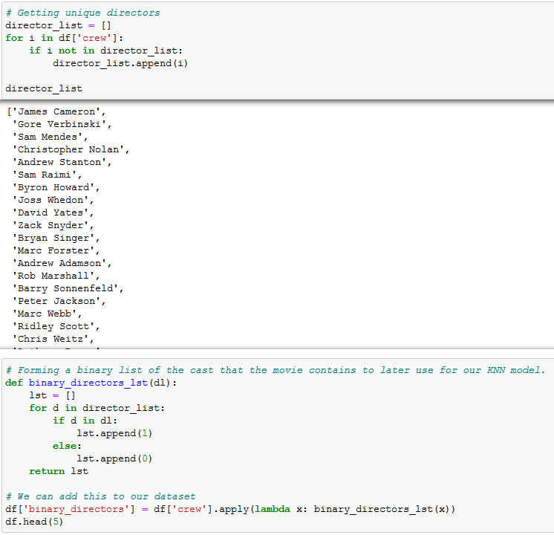
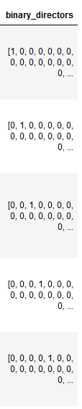
KNN with Genre and Director as Features
Like before, we take each unique director and append a 1 to the list if they are the director of the movie that is shown.

Slide 12
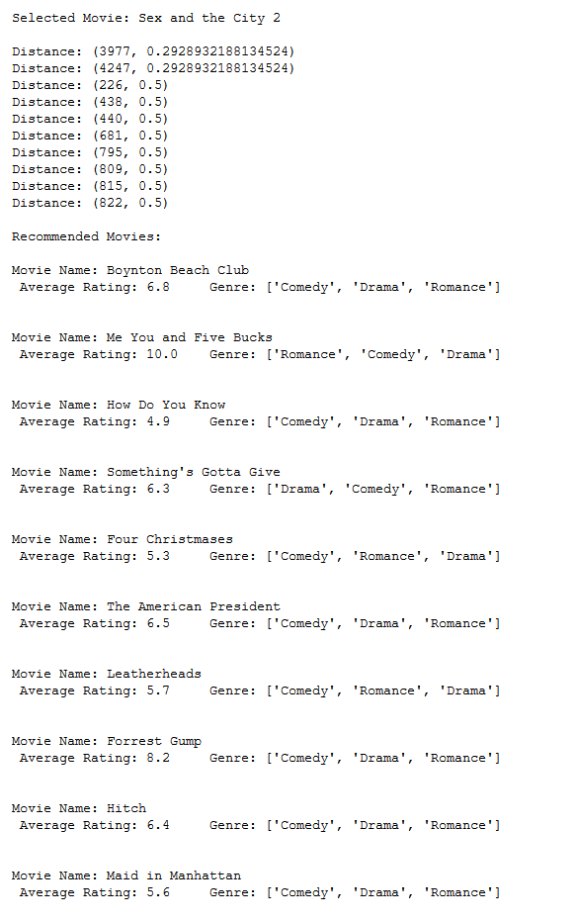
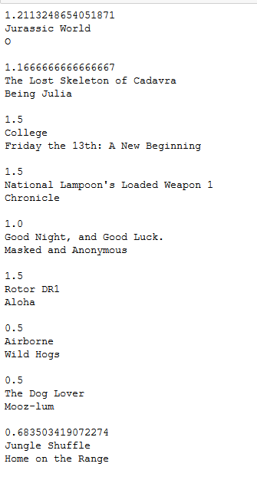
KNN with Genres and Director as Features
Overall, a very bad idea to use these two features only.
No valuable information given and only reduces distance due to the genres.

Slide 13
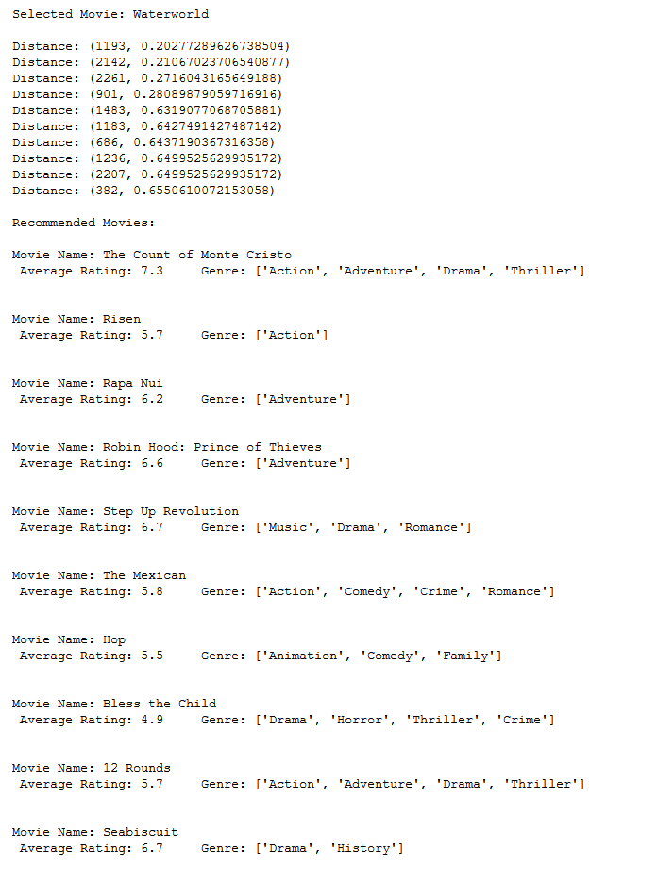
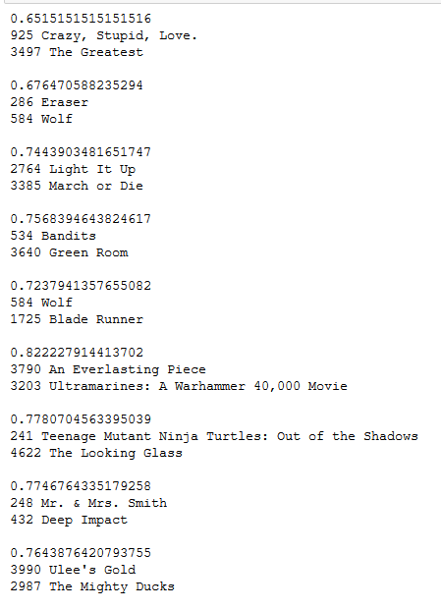
KNN with Cast and Directors as Features
Overall, this can be used to find your favorite actors and directors play in certain movies, but other than that, nothing else.

Slide 14
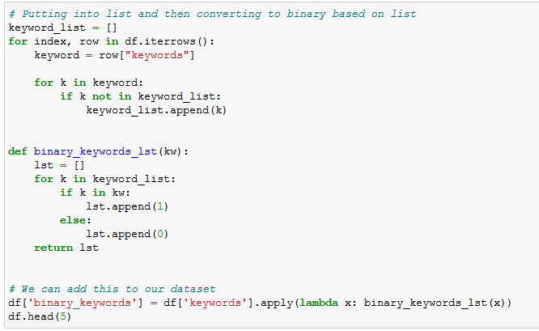
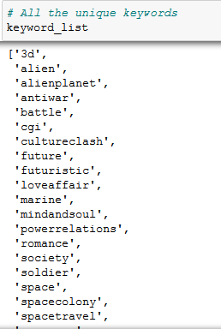
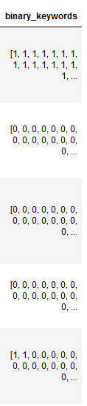
KNN with Genres and Keywords as Features
Like before, we take a list of every unique keywords used in the dataset and convert them to list where 1 represents the unique word in the movie.

Slide 15
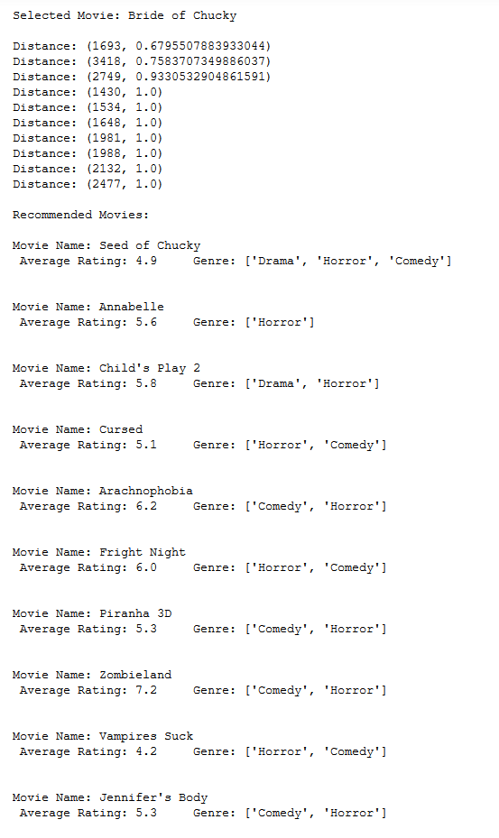
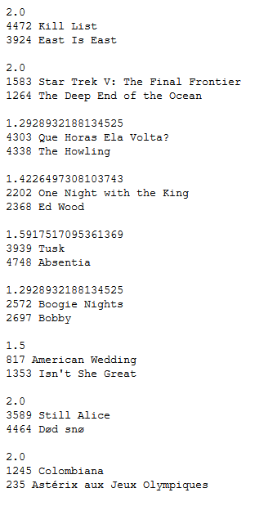
KNN with Genres and Keywords as Features
Based on these results, genre and keywords do not have much correlation together and it could be that some keywords belong to multiple genres or none of the genres in general, making it difficult for the model to figure out what is similar.

Slide 16
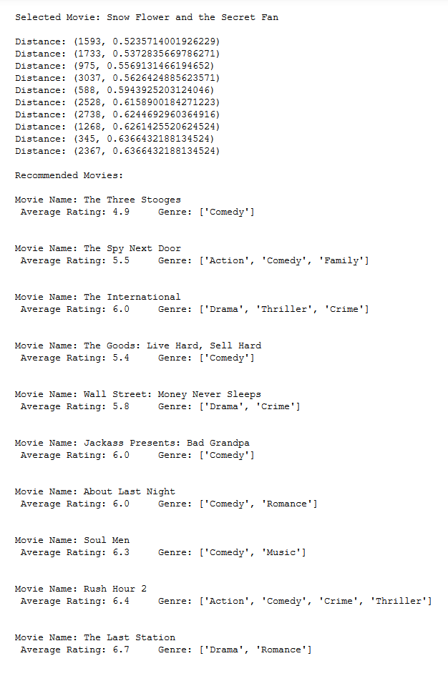
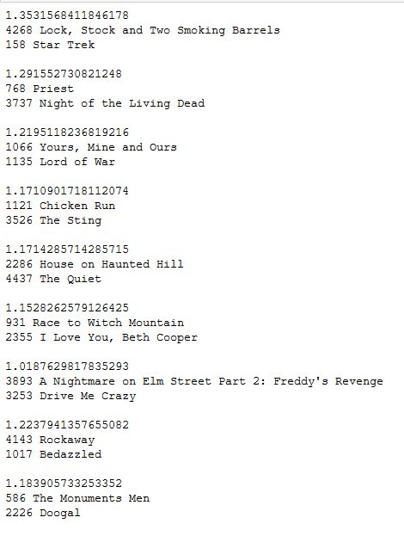
KNN with Cast and Keywords as Features
Overall, this may help us in figuring out which actors play in what kind of movies relating to the keywords, but weak in recommending us anything.

Slide 17
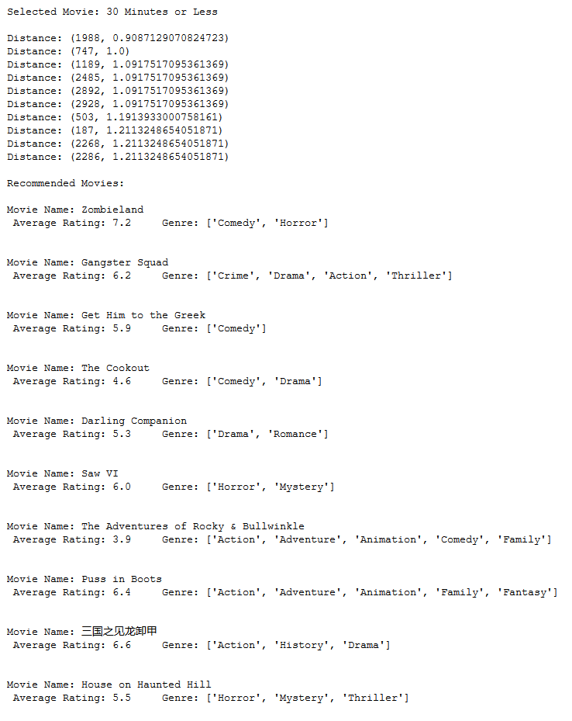
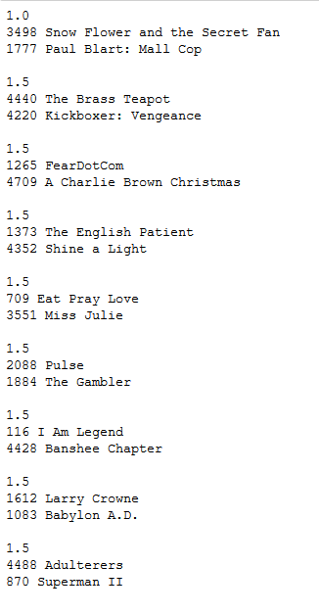
KNN with Director and Keywords as Features
Overall, this does not tell us much when it comes to recommending and it mostly using directors to lower the distances between the two movies rather than a mix of both directors and keywords.

Slide 18
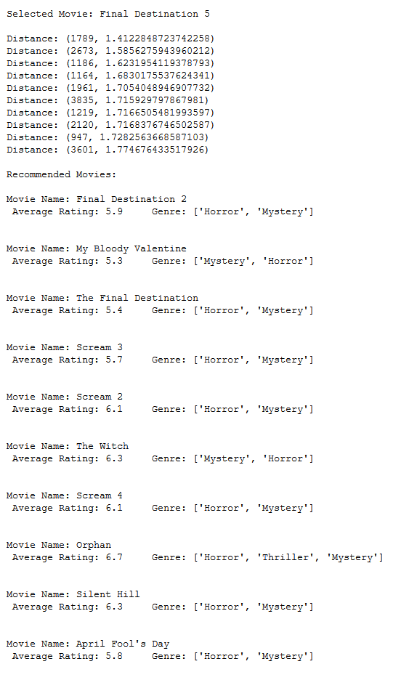
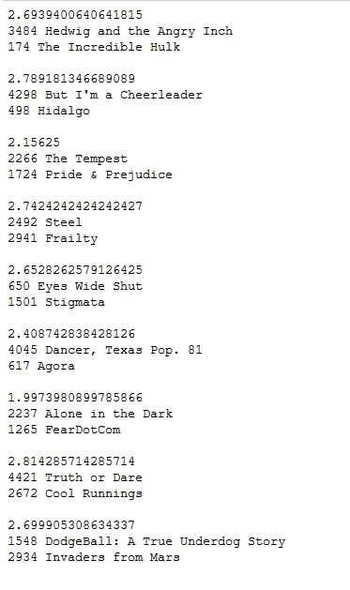
KNN with Genres, Cast, Director, and Keywords as Features
Using 4 Features gives us some big distances between the two random movies, but this means that it is getting more accurate in finding recommendations for us.

Slide 19
Conclusion/Analysis
Overall, most difficult part was setting up the models to work the way they are intended.
Based on the results, more features helps train our model to provide much more better recommendations.
Not easy to determine the accuracy other than the distances, as users can have different tastes in terms of movies.
Content based filtering recommendation systems are not often used mainly due to how users can differ in the way they watch movies.

Slide 20
Sources Used
https://medium.com/analytics-vidhya/distances-in-machine-learning-ec8c6cebbc7f
https://towardsdatascience.com/importance-of-distance-metrics-in-machine-learning-modelling-e51395ffe60d
https://towardsdatascience.com/cosine-similarity-how-does-it-measure-the-similarity-maths-behind-and-usage-in-python-50ad30aad7db
https://scikit-learn.org/stable/modules/metrics.html#cosine-similarity
https://scikit-learn.org/stable/modules/generated/sklearn.metrics.pairwise.cosine_similarity.html
https://www.machinelearningplus.com/nlp/cosine-similarity/
https://www.kaggle.com/ibtesama/getting-started-with-a-movie-recommendation-system#Collaborative-Filtering
https://towardsdatascience.com/recommender-systems-in-practice-cef9033bb23a
https://towardsdatascience.com/prototyping-a-recommender-system-step-by-step-part-1-knn-item-based-collaborative-filtering-637969614ea
https://towardsdatascience.com/how-did-we-build-book-recommender-systems-in-an-hour-part-2-k-nearest-neighbors-and-matrix-c04b3c2ef55c
https://kavita-ganesan.com/tfidftransformer-tfidfvectorizer-usage-differences/
https://scikit-learn.org/stable/modules/generated/sklearn.feature_extraction.text.TfidfVectorizer.html
https://towardsdatascience.com/beginners-recommendation-systems-with-python-ee1b08d2efb6
https://heartbeat.fritz.ai/recommender-systems-with-python-part-ii-collaborative-filtering-k-nearest-neighbors-algorithm-c8dcd5fd89b2#:~:text=When%20a%20KNN%20makes%20a,the%20most%20similar%20movie%20recommendations
https://towardsdatascience.com/machine-learning-basics-with-the-k-nearest-neighbors-algorithm-6a6e71d01761

